Slide 1
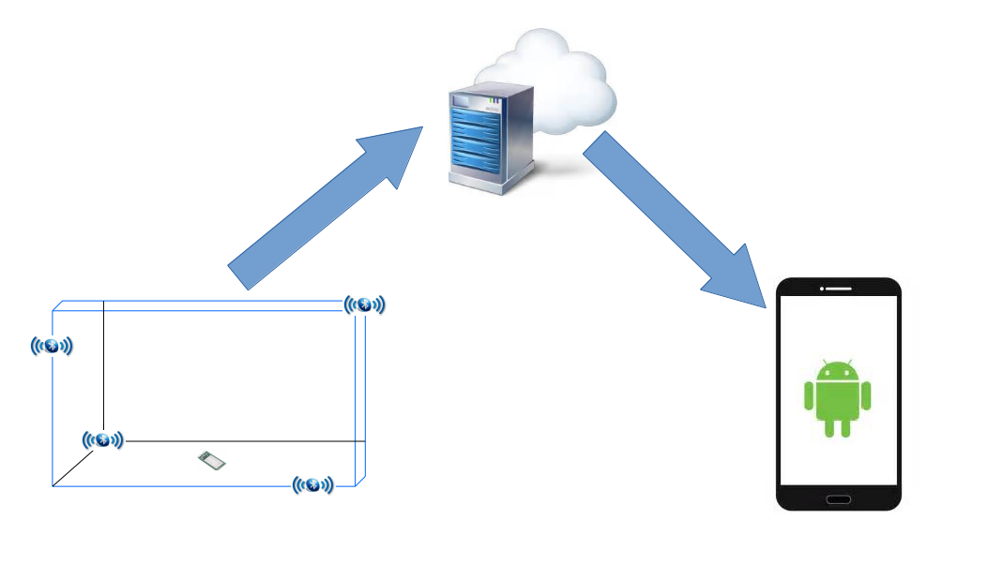
IPS Demo

Slide 2
IPS Precision and Accuracy Report

Slide 3
Testing Environmental Factors
Closed Space
With Obstacles: walls, metal object etc.
Temperature: 24 Degrees Celcius
Beacons broadcasting power: -20dbm
Beacons broadcasting frequency: 100ms
HM-10 scanning sensitivity: -84 (estimated)
Transmission range: ~16 meters
Elevation: 75cm +/- 5cm

Slide 4
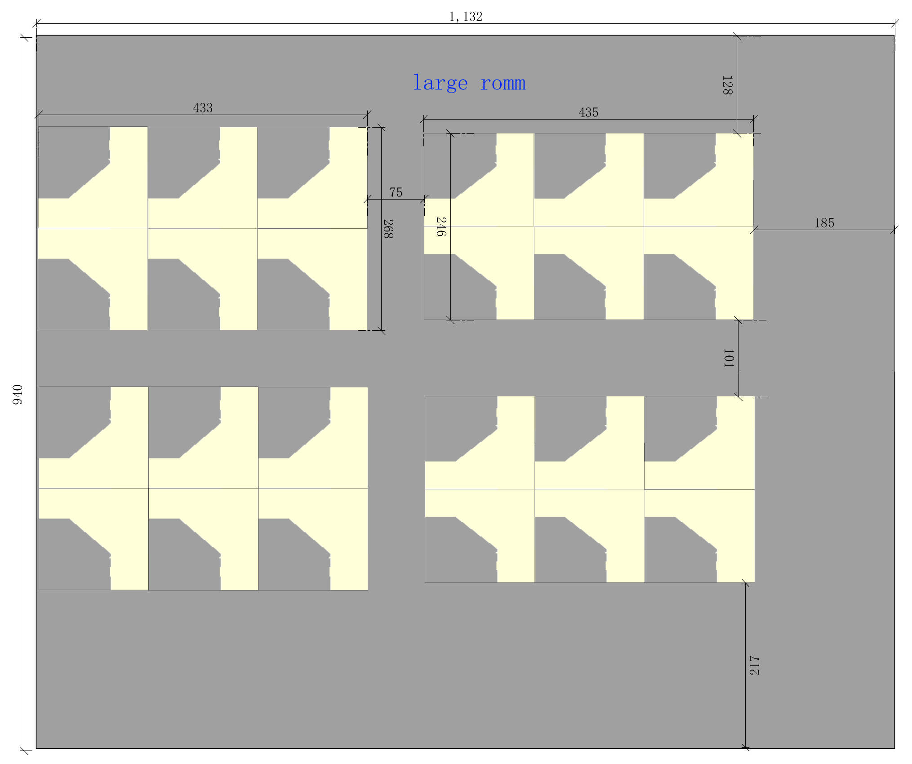

Slide 5
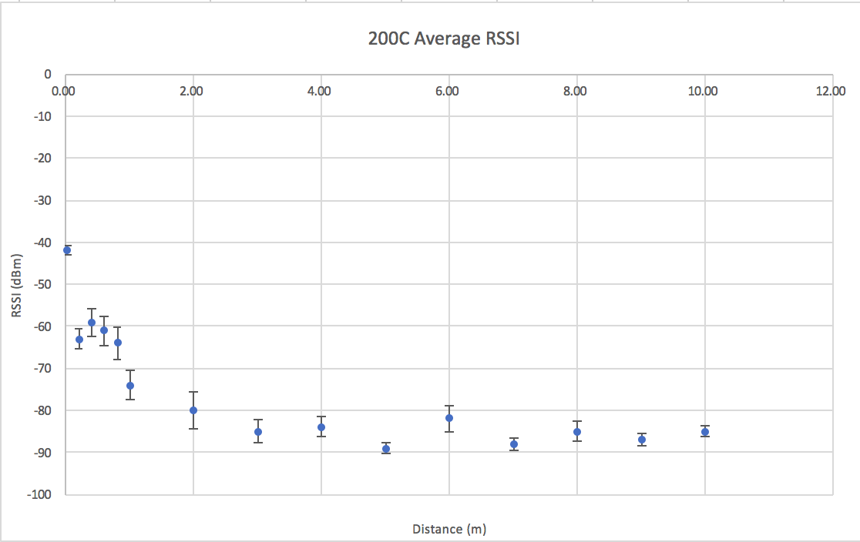
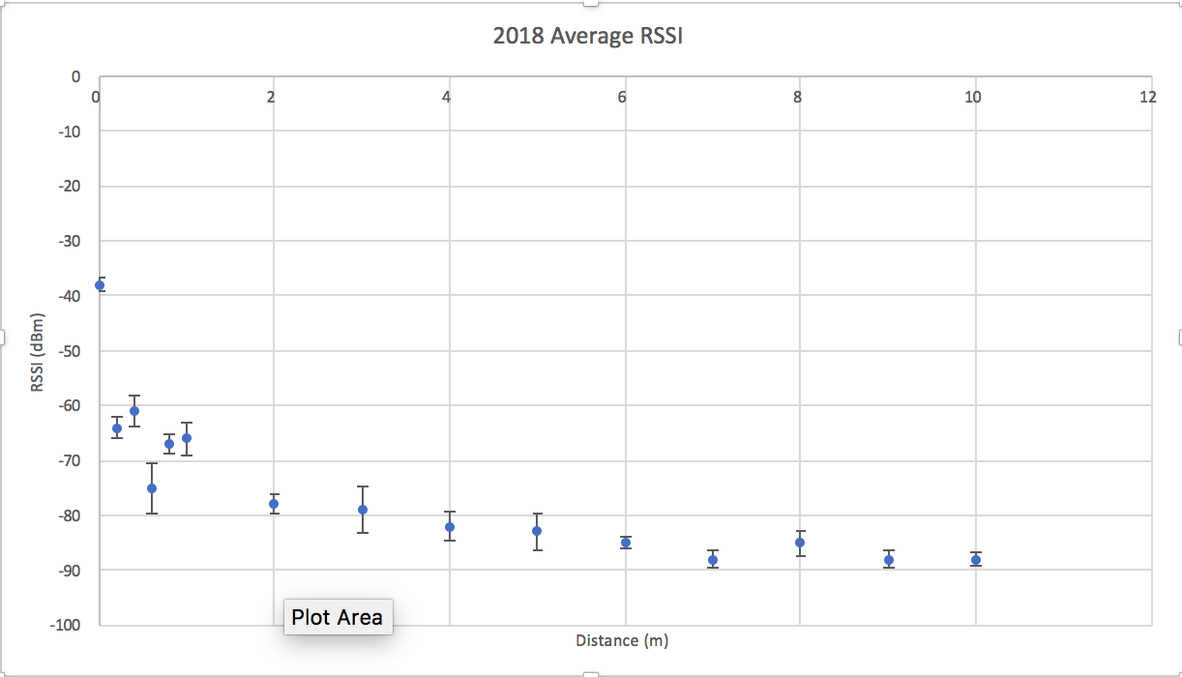
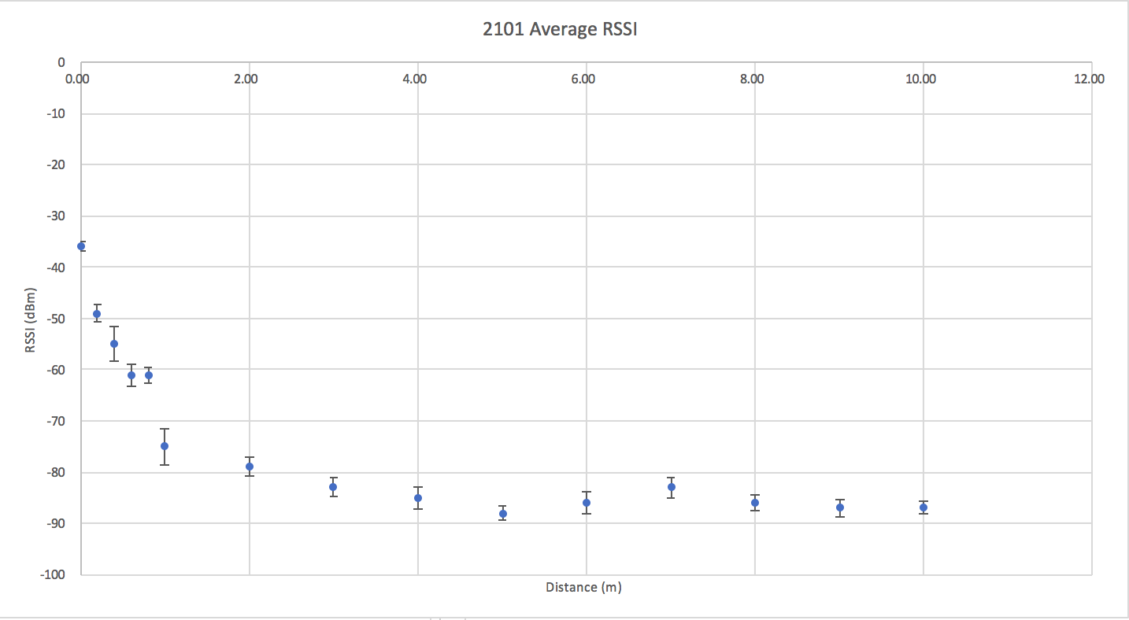
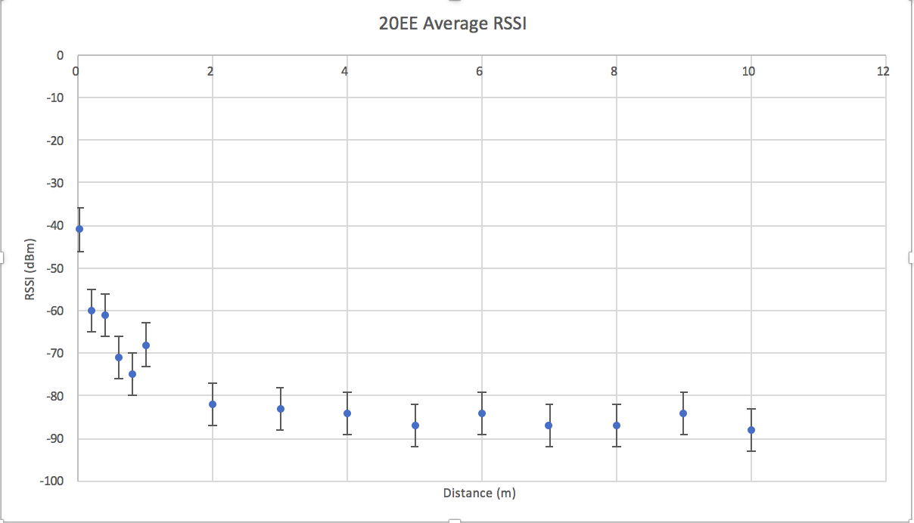

Slide 6
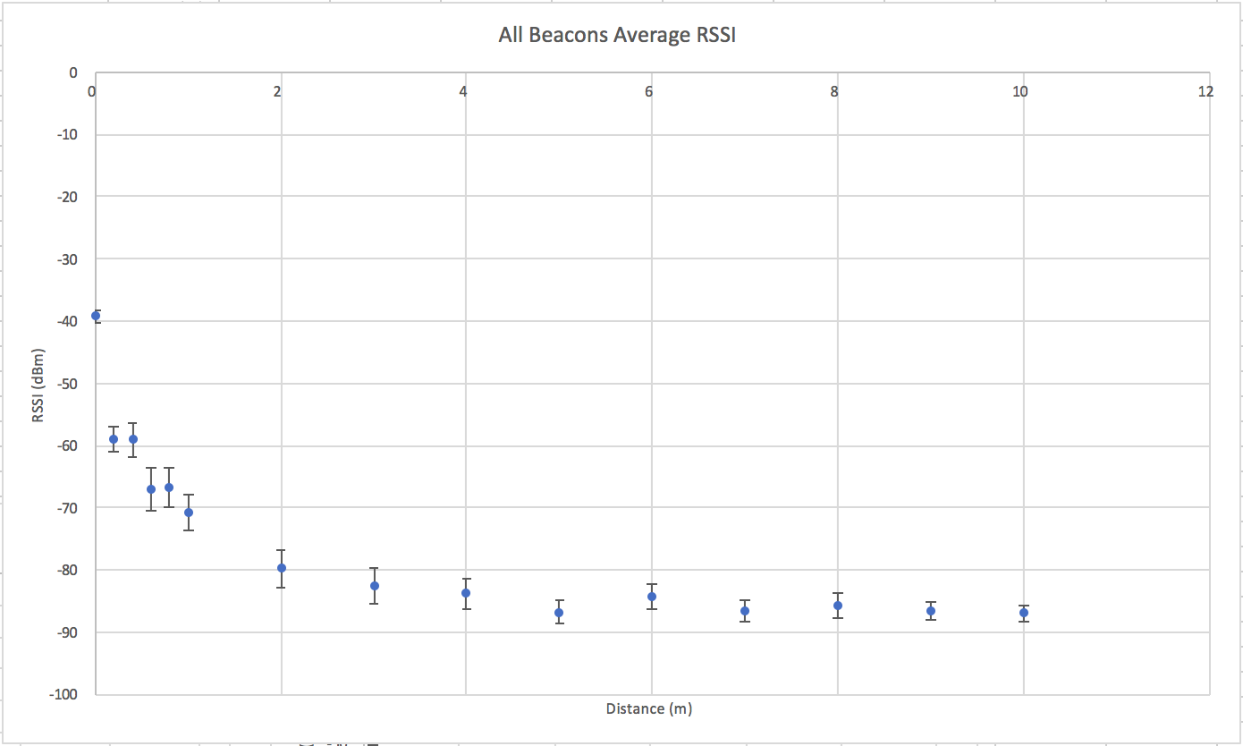

Slide 7
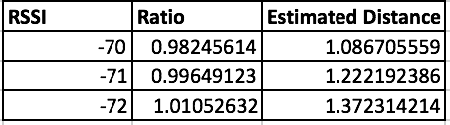
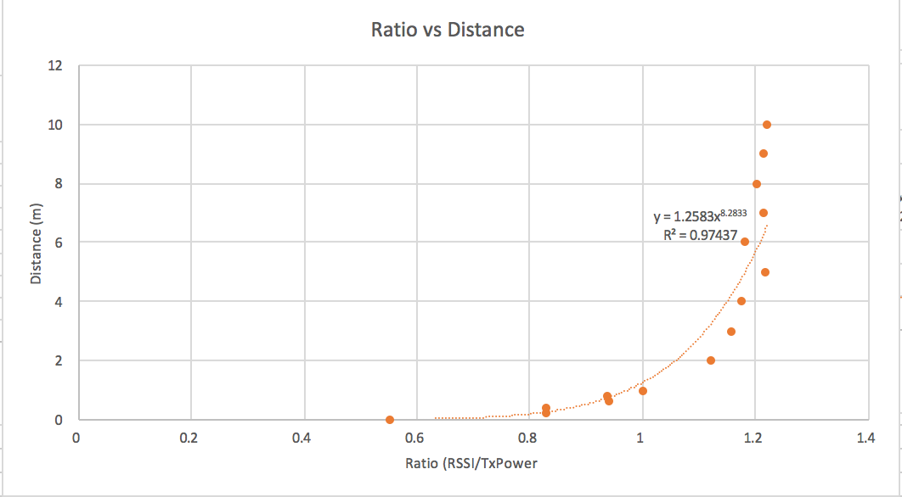
RSSI to Meters
Finding the best equation
Balancing Data Trend Expectation, R-squared correlation value, and continuity

Slide 8
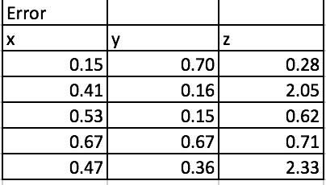
Meters to Coordinate
Uses same optimization algorithm every time → very precise
Accuracy dependent on RSSI scanning precision and RSSI to Meters accuracy
More data points will be collected

Slide 9
Method to Gathering RSSI
Moving average variation (average of old overage + new data point)
Takes ~3 seconds to scan
Prevents extreme fluctuations
Changes take long time to update
Are there better ways?
Average of all data points in history
New data point
New Average

Slide 10
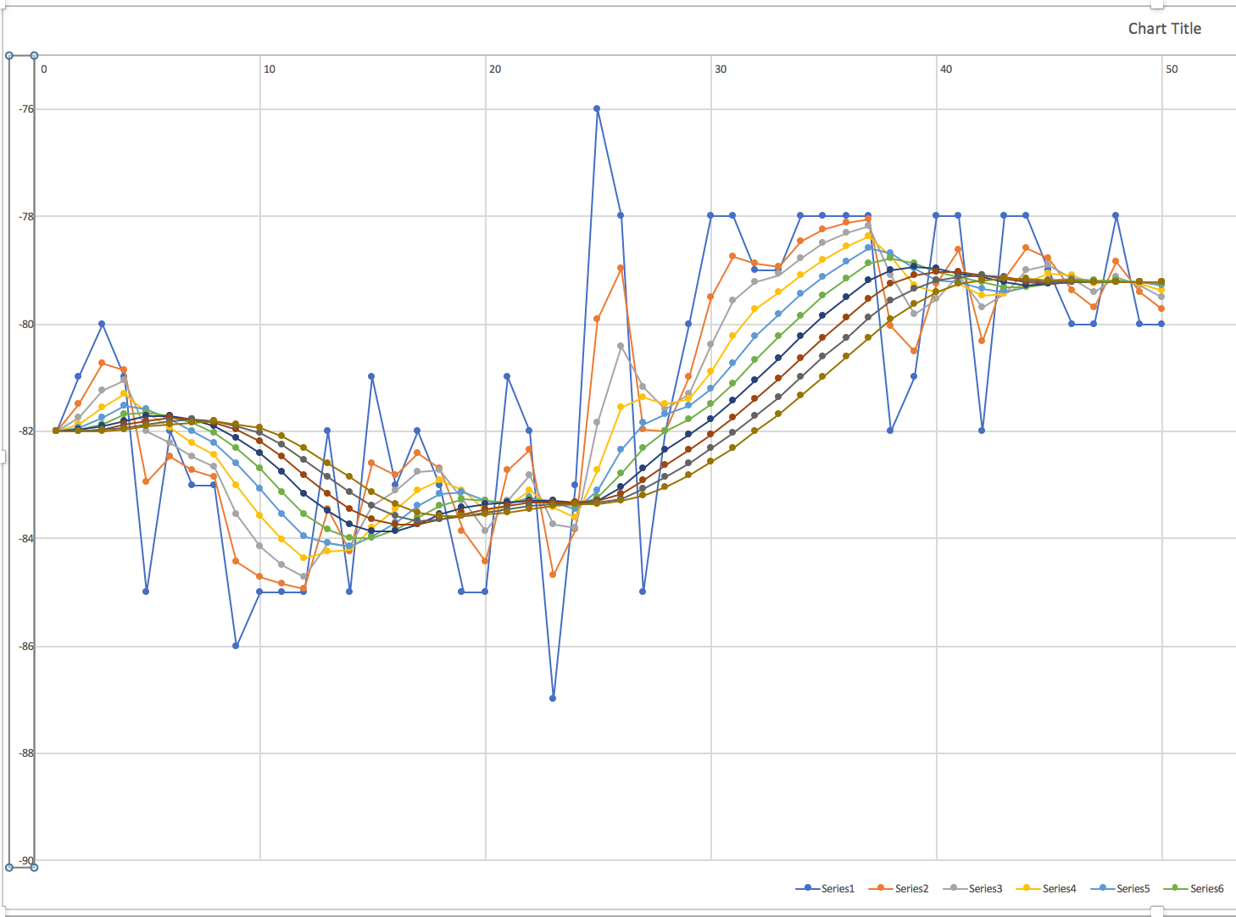

Slide 11
Issues
Linklt Arduino unable to process RSSI averages (might be processing power issue)
Unstable communication between 7688 and Arduino boards
Might not get all beacons on every scan

Slide 12
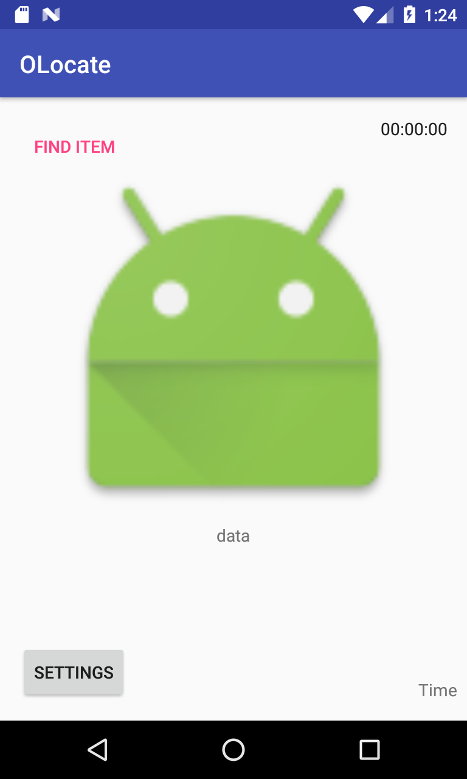
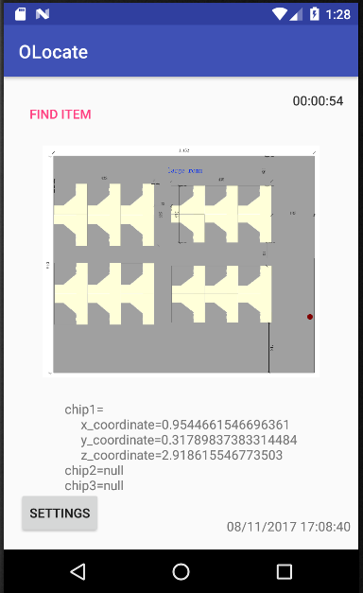
App UI

